Slide 1
Module Thermal Model
Notes:
Notes te

Slide 2
Mathematical module thermal model
Notes:
Some papers seem to use a total net heat generation from each cell

Slide 3




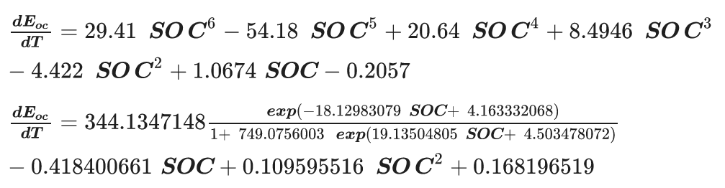
A simplified thermal model for a lithium-ion battery pack with phase change material thermal management system Bilal Lamrani
,
,
R = Internal resistance
Notes:
Seems heavily SoC dependent, Also relies on pcm

Slide 4


A lumped electro-thermal model for a battery module with a novel hybrid cooling system Jiacheng He

Slide 5
Battery thermal models for hybrid vehicle simulations Ahmad A. Pesaran
Lumped capacitance thermal model
Resistance/capacitance model
Partnership for a new generation of vehichles (PNGV) model
Neural network lead/acid model
Fundamental lead/acid model
Notes:
Link to website dead

Slide 6
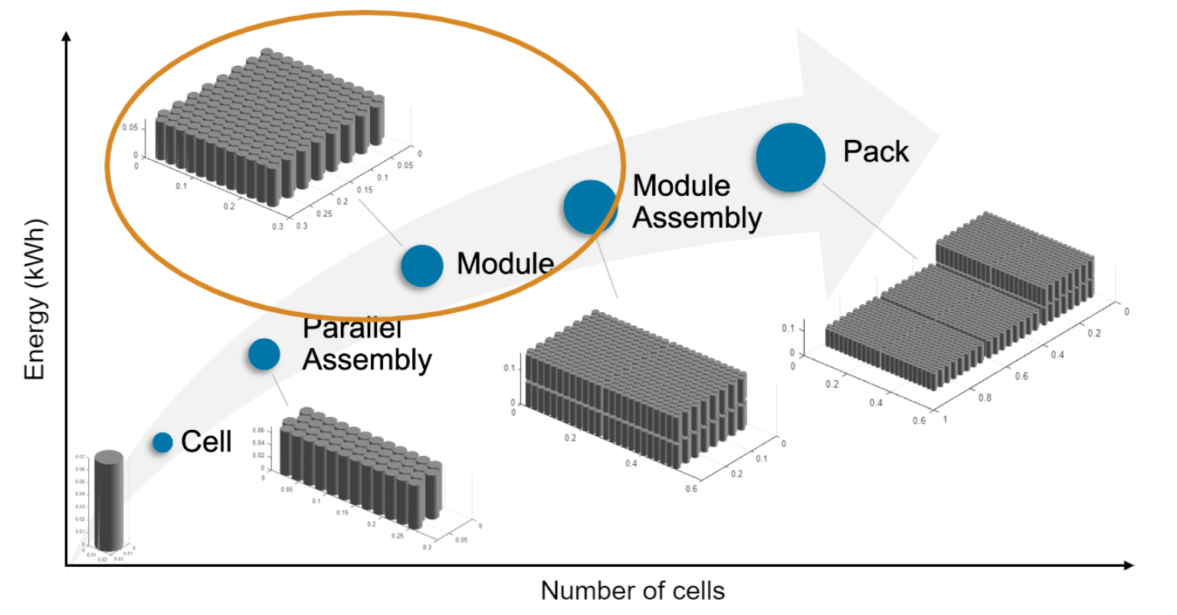
Module model for simulation
Simscape Battery
Also Battery modelling
from Javier Gazzarri

Slide 7


Last week – MPC objective function
Duty cycle control:
Current deviation from ref.
Minimize duty cycle changes
Resistance control
Current deviation from ref.
Minimize resistance changes
Smooth current profile

Slide 8


